Slide 1
General Disease Prediction System
Cochin University of Science and Technology
By Guide: Dr. Rafidha Rehiman KA, Asst. Prof. DCA
Raj Kishore Yadav
Sitanshu Shekhar
Kumar Shubham
Saurabh Kumar

Slide 2
Abstract
The project aims to develop a web application for “General Disease Prediction System”.
Our project integrates a user friendly platform to cross validate results at the go and to spread general awareness and provide precautionary measures.
With the advancement in technologies and mobile phones being the most used user-friendly device, our team has come with an application that provides a prediction of the two most caused lifestyle diseases like Diabetes and Heart Disease at your hand.

Slide 3
Abstract
General Disease Prediction System (GDPS) allows you to make important predictions about the severity of an ongoing disease with few inputs given by user of parameters.
Today, time is the factor and being healthy is also an essential so this idea will help users and also encourage the idea of using Internet more widely.

Slide 4
Content
Introduction
Technologies Used
Problem Statement
Proposed Solution
Dataset
Algorithm
Deployment on heroku
Conclusion
Reference

Slide 5
Introduction
The General Disease Prediction System (GDPS) is for those who often feel reluctant to go to hospital or physician on minor symptoms.
However, in many cases, these minor symptoms may trigger major health hazards. As online health advice is easily reachable, using GDPS can be a great head start for users.

Slide 6
Introduction
Moreover, existing online health care systems suffer from lack of reliability and accuracy. Here in, we propose a system that relies on guided user input.
The system takes input from the user and provides a report of user’s condition on mentioned diseases. Before doing anything we did a decent research on rapid escalation of Internet technology and data for which handheld devices has opened up new avenues for online healthcare system.

Slide 7
Technologies Used
HTML, CSS, JavaScript
Python
Machine Learning
Flask
Heroku
Git

Slide 8
Goal
The Goal of General Disease Prediction System is to develop a basic model which will provide the prediction of heart disease and diabetes using symptoms as a parameter given by the user.
Disease Prediction has been already implemented using different techniques like Neural Network, decision tree and various algorithms.
So, our disease predictor uses SVM and logistic regression algorithms for the prediction of different diseases.

Slide 9
Problem Statement
It is estimated that more than 70% of people in India are prone to heart disease and diabetes every year.
This may because many people don't realize that the general body diseases could be symptoms to something more harmful, 25% of the population succumbs to death because of ignoring the early general body symptoms.
Hence identifying or predicting the disease at the earliest is very pivotal to avoid any unwanted casualties.

Slide 10
Proposed Solution
Concerning to the problem stated above we are going to implement support vector machine or SVM and logistic regression that predicts the seriousness of selected disease as per the input entered by the user.
Besides this we aim to design and develop a user friendly and efficient web application based disease prediction System.

Slide 11
Dataset
Heart Disease Dataset => 305 records
Attributes:-
Age
Sex
Chest pain type (4 values)
Resting blood pressure
Serum cholesterol in mg/dl
Fasting blood sugar > 120 mg/dl
Resting electrocardiographic results (values 0,1,2)
Maximum heart rate achieved
Exercise induced angina
Old peak = ST depression induced by exercise relative to rest
The slope of the peak exercise ST segment
Number of major vessels (0-3) colored by flourosopy
Thal: 0 = normal; 1 = fixed defect; 2 = reversable defect
Target: Class variable (0 or 1)

Slide 12
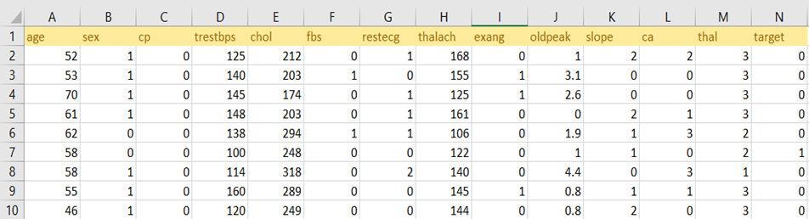
Heart Disease Dataset

Slide 13
Dataset
Diabetes Dataset => 770 records
Attributes:-
Pregnancies: Number of times pregnant
Glucose: Plasma glucose concentration a 2 hours in an oral glucose tolerance test
BloodPressure: Diastolic blood pressure (mm Hg)
SkinThickness: Triceps skin fold thickness (mm)
Insulin: 2-Hour serum insulin (mu U/ml)
BMI: Body mass index (weight in kg/(height in m)^2)
DiabetesPedigreeFunction: Diabetes pedigree function
Age: Age (years)
Outcome: Class variable (0 or 1)

Slide 14
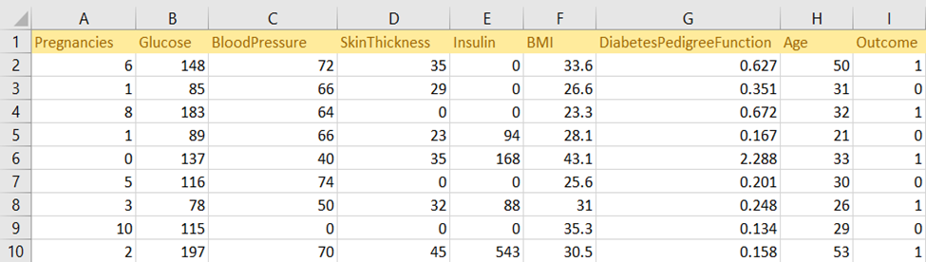
Diabetes Dataset

Slide 15
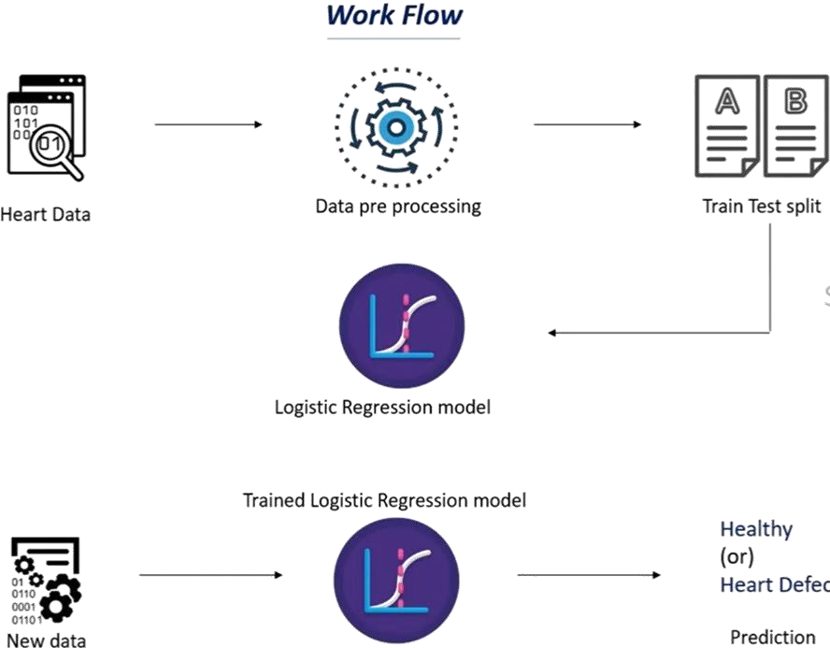
Work Flow of Heart Disease Model

Slide 16
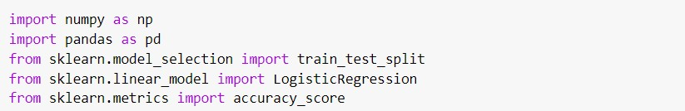
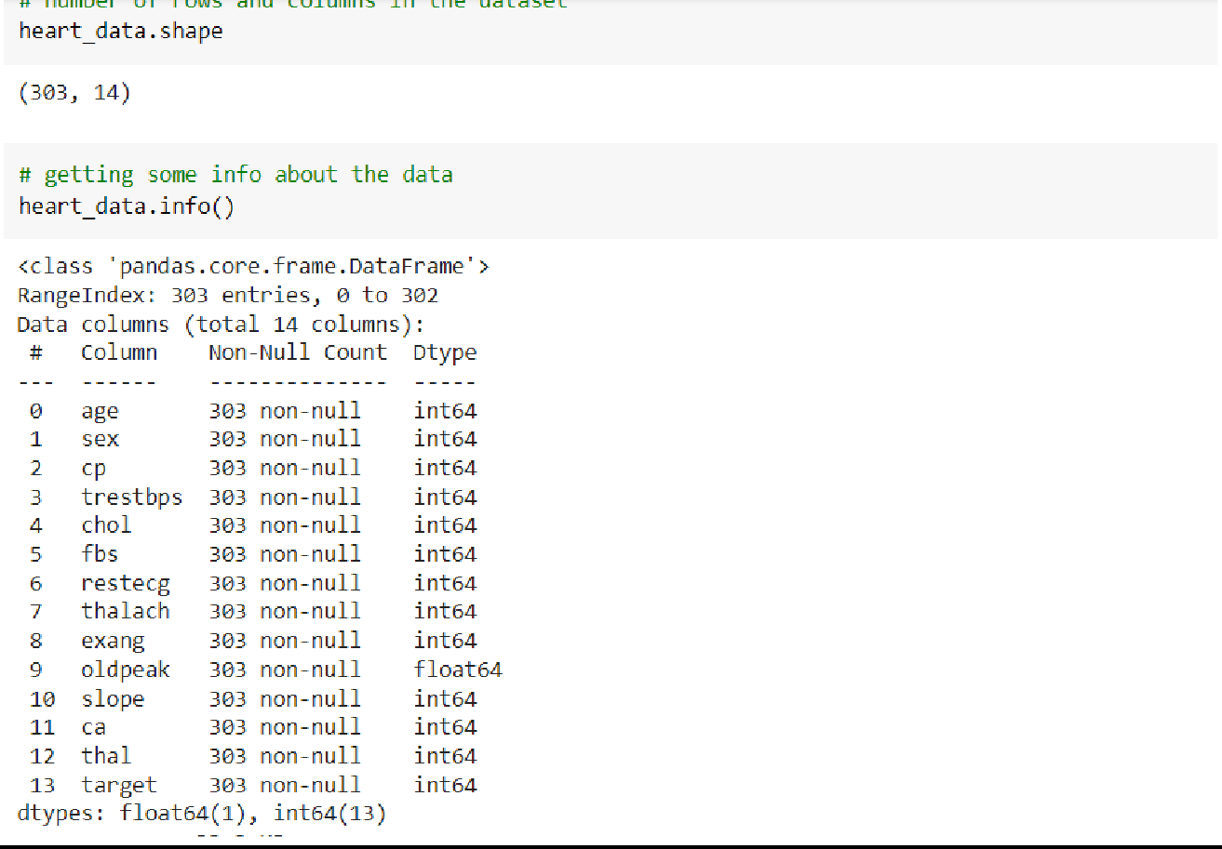
Data Collection & Processing

Slide 17
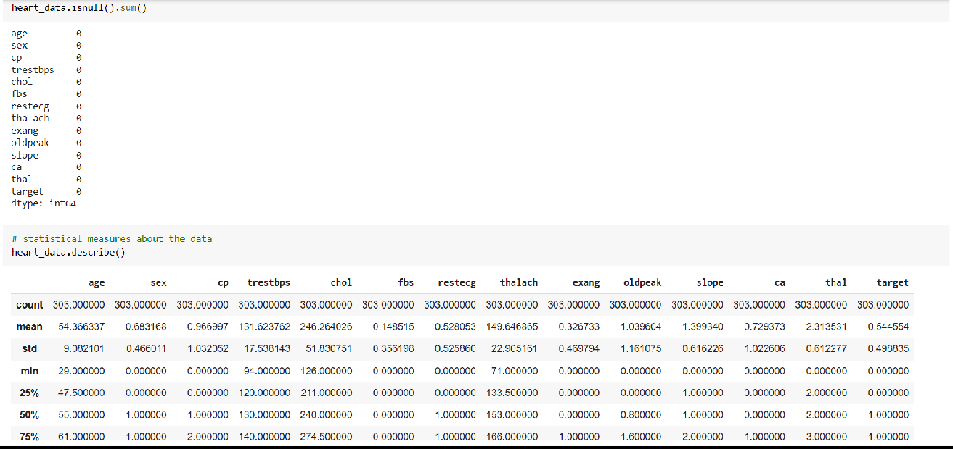
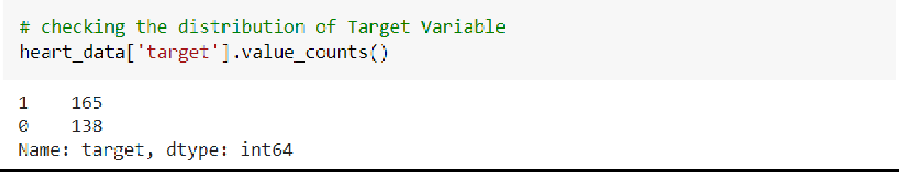
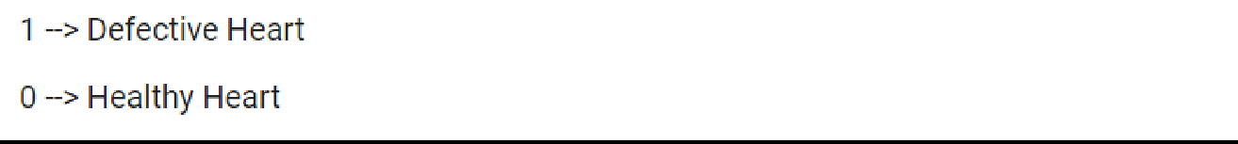

Slide 18
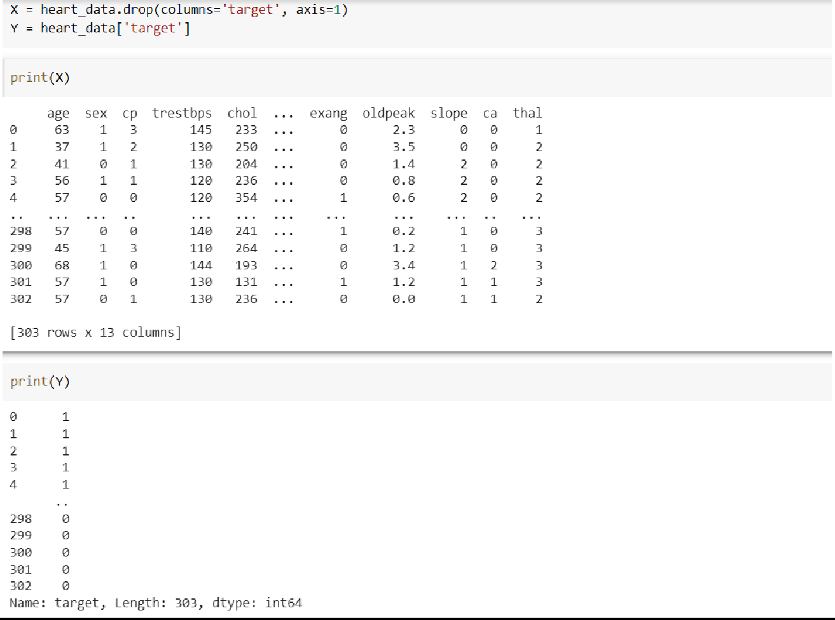
Splitting the Features and Target

Slide 19
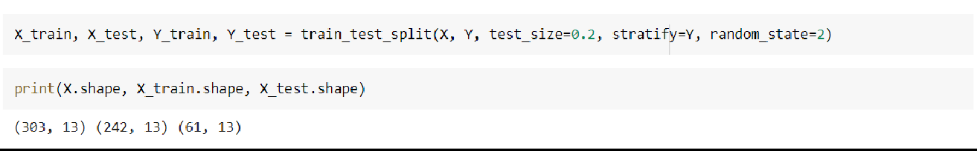
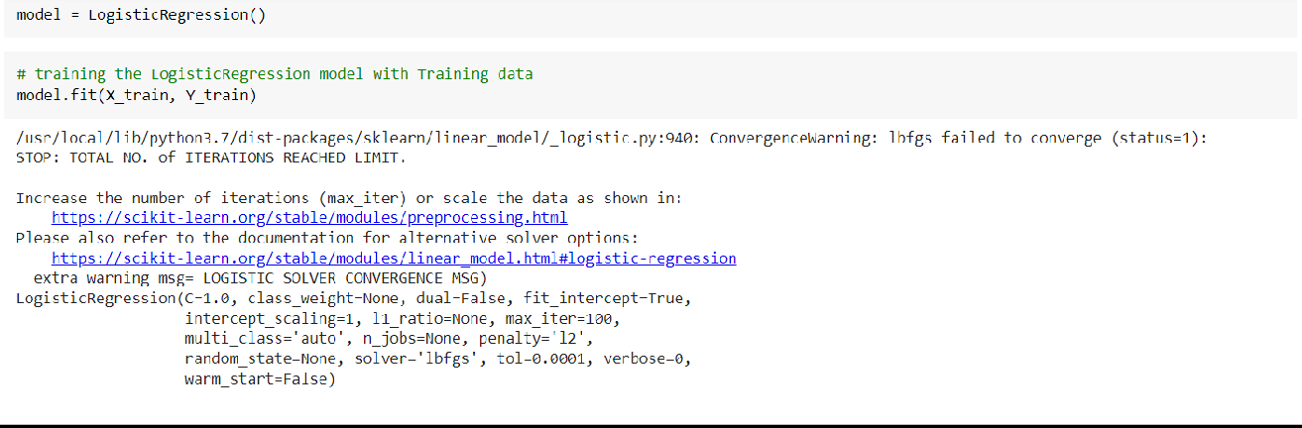
Model Training(Logistic Regression)

Slide 20
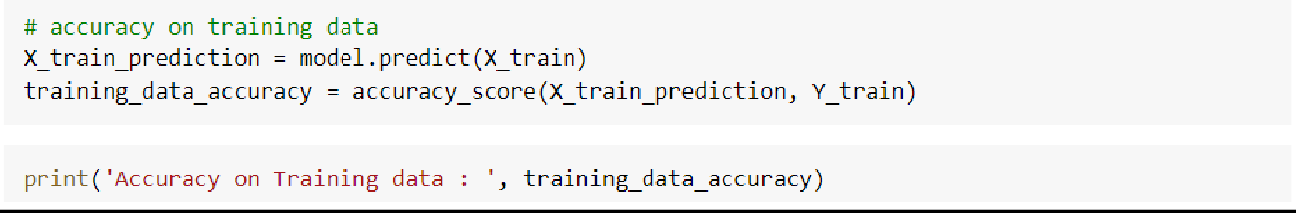
Model Evaluation
Accuracy of heart disease prediction model is 77%

Slide 21
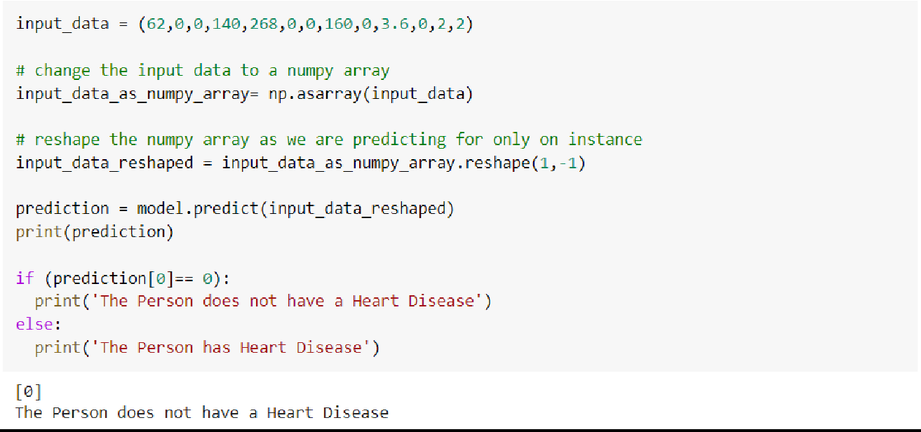
Model Prediction

Slide 22
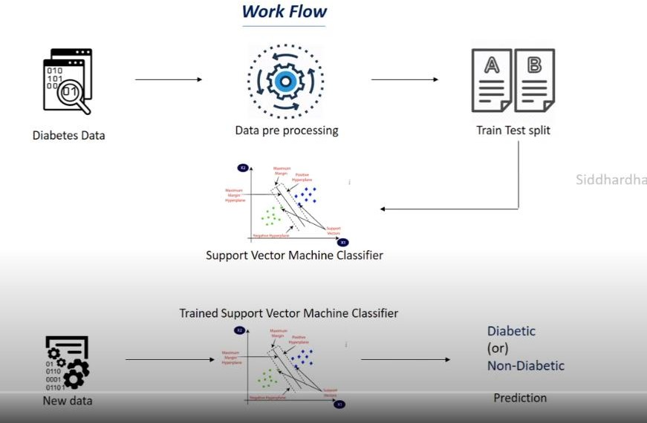
Work Flow of Diabetes Model

Slide 23
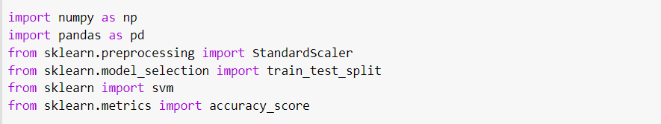
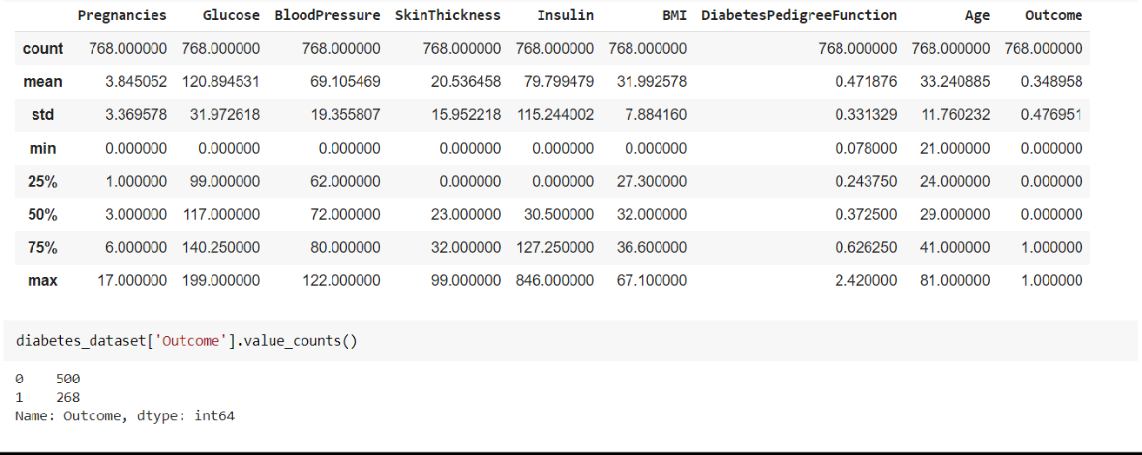
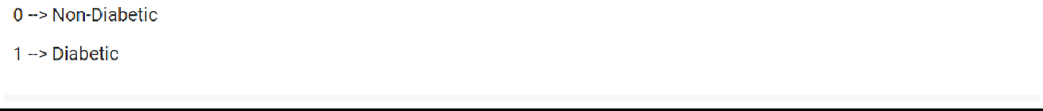
Data Collection & Processing

Slide 24
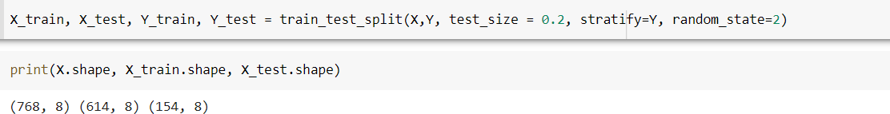
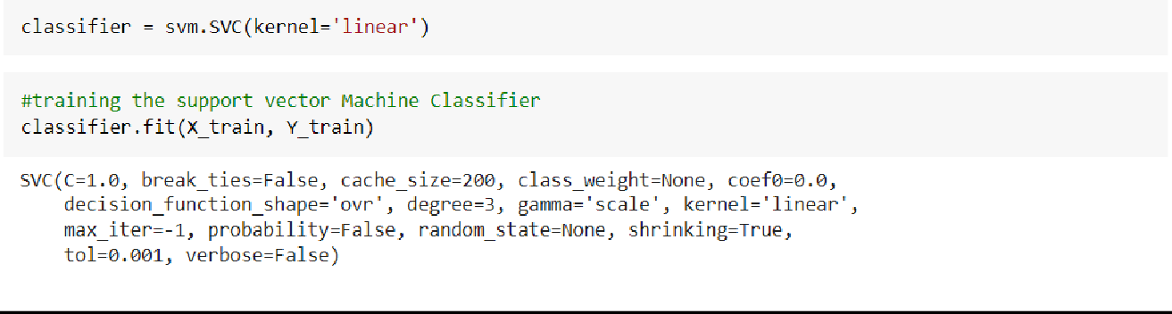
Splitting Data
Model Training(SVM)

Slide 25
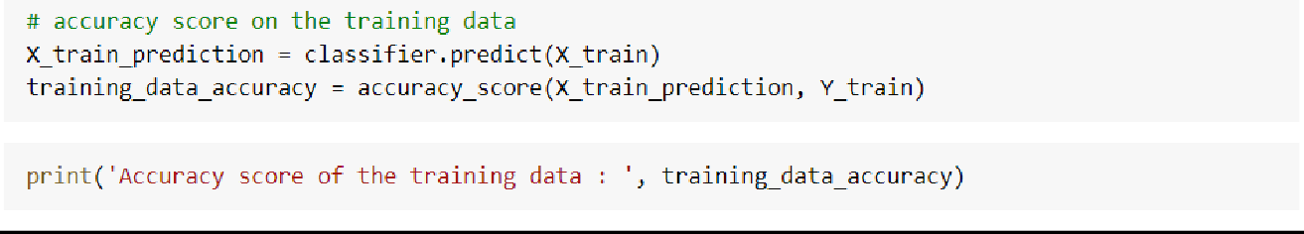
Model Evaluation
Accuracy of Diabetes prediction model is 81%

Slide 26
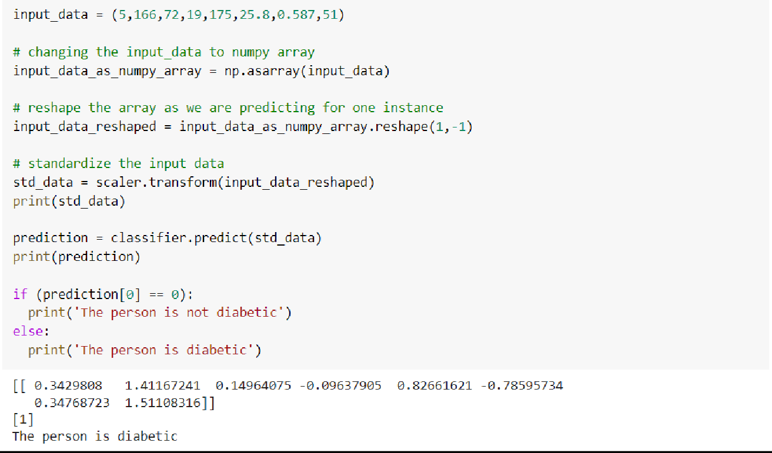
Model Prediction

Slide 27
Algorithm
Support Vector Machine:
A support vector machine (SVM) is machine learning algorithm that analyses data for classification and regression analysis. SVM is a supervised learning method that looks at data and sorts it into one of two categories.
An SVM outputs a map of the sorted data with the margins between the two as far apart as possible. SVMs are used in text categorization, image classification, handwriting recognition and in the sciences.

Slide 28
Algorithm
Logistic Regression:
Logistic regression is a statistical analysis method used to predict a data value based on prior observations of a data set.
A logistic regression model predicts a dependent data variable by analysing the relationship between one or more existing independent variables.

Slide 29
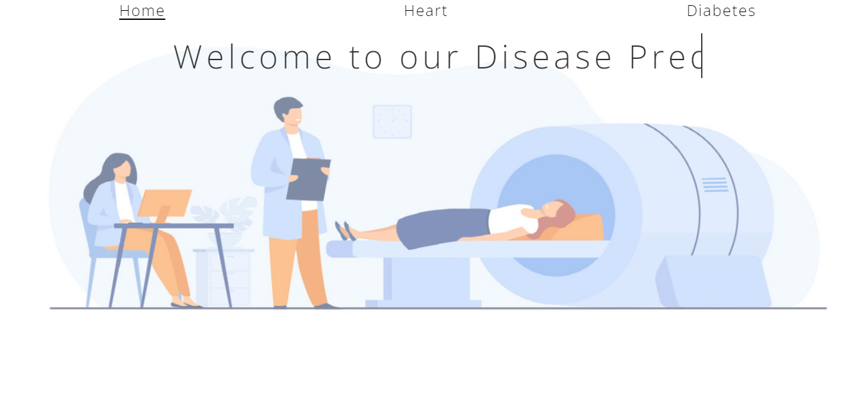
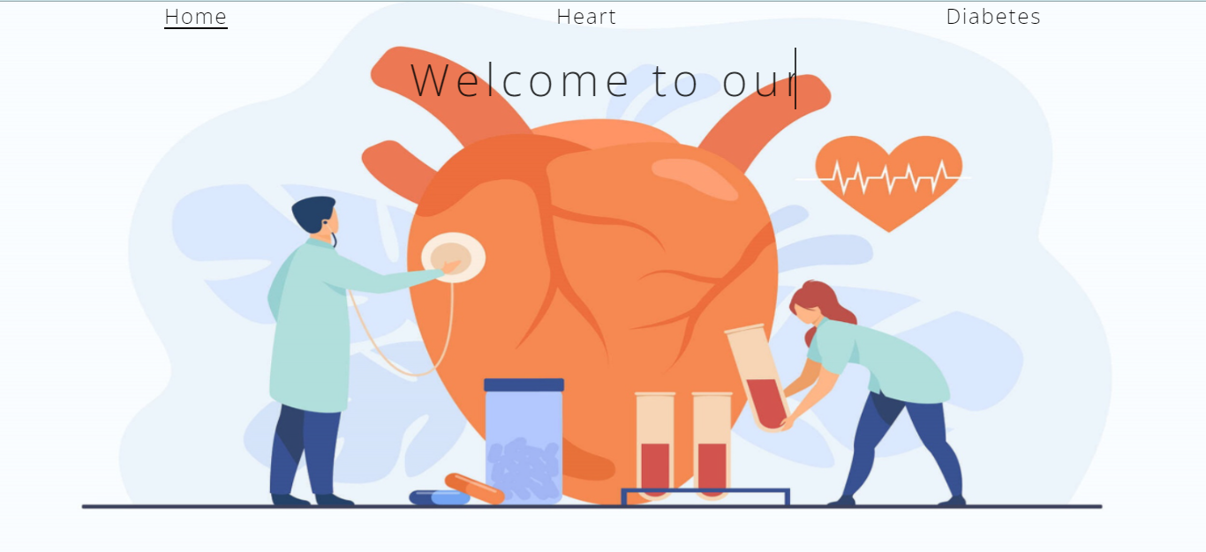
Front-end

Slide 30
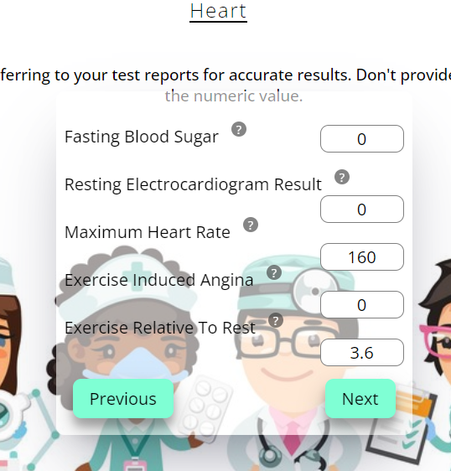
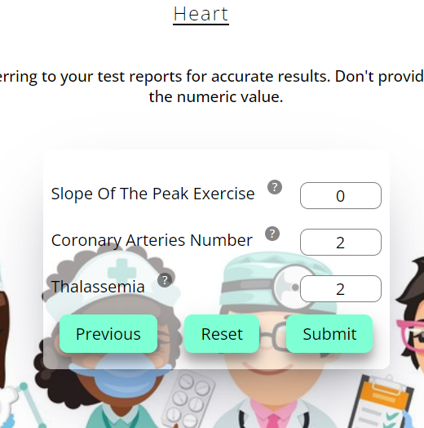
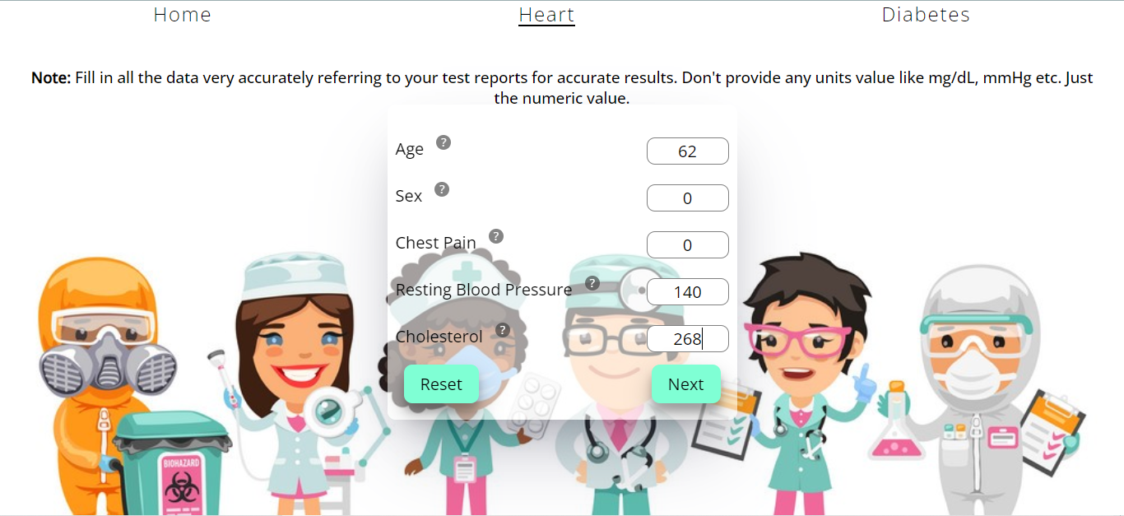
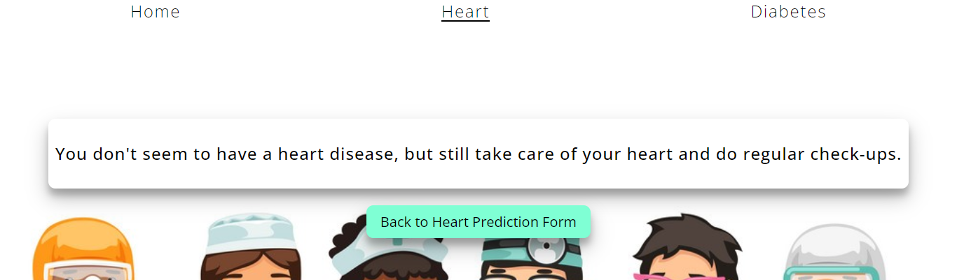
Front-end (Heart Disease)

Slide 31
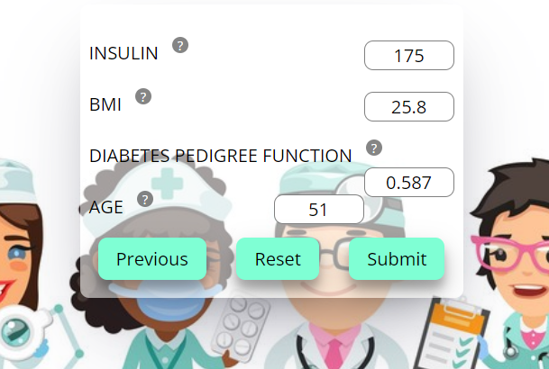
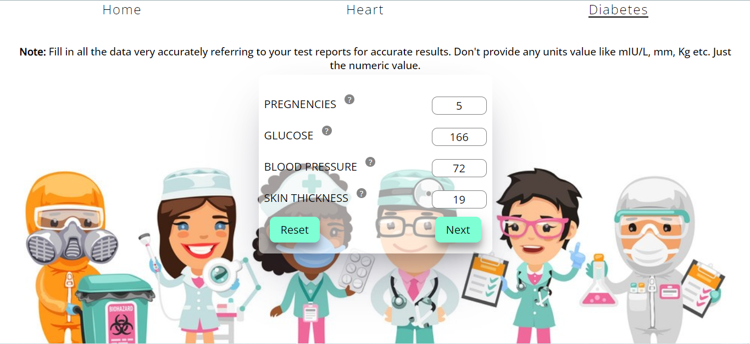
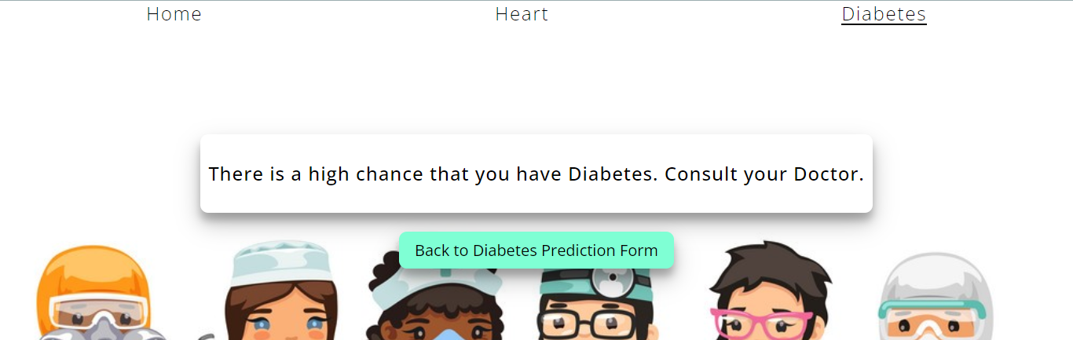
Front-end (Diabetes)

Slide 32
Deployment on heroku
http://gdps-07.herokuapp.com/

Slide 33
Conclusion
This project aims to predict the disease on the basis of the inputs given by the user.
The project is designed in such a way that the system takes input from the user and provides a report of user’s condition i.e. predict disease’s prevalence in body.

Slide 34
Future-Scope
As the current system covers only two diseases the plan is to include disease of higher fatality, like various cancers, so that early prediction and treatment could be done.
This project has not implemented recommendation of medications to the user. So, medication recommendation can be implemented in the project.
History about the disease for a user can be kept as a log and recommendation can be implemented for medications.

Slide 35
References
https://www.kaggle.com/code/arkalodh/diabetes-prediction-easy/data
https://www.kaggle.com/datasets/johnsmith88/heart-disease-dataset
https://www.educba.com/svm-algorithm/
https://online.stat.psu.edu/stat462/node/207/
Prediction of heart disease and classifiers' sensitivity analysis - PubMed (nih.gov)
http://refhub.elsevier.com/S2352-9148(21)00180-5/sref26
http://refhub.elsevier.com/S2352-9148(21)00180-5/sref18
Qawqzeh Y. K., Bajahzar A. S., Jemmali M., Otoom M. M., Thaljaoui A. Classification of diabetes using photoplethysmogram (PPG) waveform analysis: logistic regression ing. BioMed Research International . 2020;2020:6. doi: 10.1155/2020/3764653.3764653 [PMC free article] [PubMed] [CrossRef] [Google Scholar]

Slide 36
References
Pethunachiyar G. A. Classification of diabetes patients using kernel based support vector machines. Proceeding of the 2020 International Conference on Computer Communication and Informatics (ICCCI); January 2020; Coimbatore, India. IEEE; pp. 1–4. [Google Scholar]
Ahuja R., Sharma S. C., Ali M. A diabetic disease prediction model based on classification algorithms. Annals of Emerging Technologies in Computing . 2019;3(3):44-52.doi: 10.33166/aetic.2019.03.005. [CrossRef] [Google Scholar]
Mohapatra S. K., Swain J. K., Mohanty M. N. Detection of diabetes using multilayer perceptron. Proceeding of the International Conference on Intelligent Computing and Applications; December 2019; Ghaziabad, India. Springer; pp. 109–116. [CrossRef] [Google Scholar]

Slide 37
THANK YOU 😊

